Slide 1

Medical Store-Distributor-Consumer Network
Design and 30% Presentation Template
Abdulla Iqbal FA17-BSE-030
Armaghan Hassan FA17-BSE-045
Majid Durani FA17-BSE-021
Supervisor: Sir Kashif Nasir
Department of Computer Science
COMSATS University Islamabad, Abbottabad Campus

Slide 2
Agenda of the Presentation
Agenda of the presentation is to study the following:
Software Requirement Document
Software Design Document

Slide 3
Brief Introduction
The Medical Store Distributor Consumer Network (MSDCN) is a medicine stock inventory system which will be used in Medical store and Pharmaceutical companies. This website will store details of medicine purchase and selling. The system will maintain purchases and selling detail w.r.t retailer and company. The system will consist of automatic billing and reporting module. Furthermore, the website will also help the shopkeeper to automatically place the order if the stock is short from the shop and will be able to see the status about his or her shipment.

Slide 4
Scope
Our system will target Medicine market.
The problem with current medicine market is that all the communication, transactions, order placing, and order delivery is based on paperwork and wire transfers which results in delays and no monitoring.
Our system will provide online platform for both Medical Stores and Pharmaceutical Companies.
It will allow them to monitor transaction, order details, order delivery status, point of sale details, inventory managements.
Physical Order Delivery will not be covered by this system.

Slide 5
Functional Requirements
FR-1: A new user would be able to get register by proving the required credentials.
FR-2: User cannot login until Admin verifies them(Payment, License).
FR-3: User shall be able to select the desired package.
FR-4: User can register multiple times but Email, License No Must be different.
FR-5: User shall be able to login, will use Email and password.
FR-6: Retailer should be able to buy the medicines from the Distributor online and he can also pay for that order by credit card or payment on delivery.
FR-7: Retailer shall be able to use the point of sale to sell their product to the Customer.
FR-8: User should be notified if the product is about to get out of stock.
FR-9: User should be able to mentain their inventory by adding, deleting and updating the items.
FR-10: User should be able to manually update the stock in the inventory.
FR-11: When Distributer add the product in the inventory it should automatically be available to the Retailer at the online market.
FR-12: User should be able to generate reports based on Daily, Monthly and Yearly.
FR-13: User should be able to see their transection detail
FR-14: User Should be able to only change the address, email, password, contact and credit card details
FR-15: Physical delivery of medicine is not goanna be a part of the system.

Slide 6
Non-Functional Requirements
User shoulder be able to learn how to operate the website with in 30 min of training.
Down time of the website should not exceed more than 10 sec for continuous succession of 500 hrs.
Website should be able to handle 100 hits per minute.
Website should be able to work on any browser.
User should be notified if the product less than 7.
The system development process and deliverable documents shall conform to the ISO STANDARDS
The system shall not disclose any personal information about members of the MSDCN to other members except system administrators.
Credit Card details should be stored in an encrypted form.
Medicine Retailer price and Distributor price should be set by themselves.
Our company is complied with the local and national laws regarding the use of software tools.

Slide 7
User Goals
Retailer:
We want to place the order to the distributor by online mean and without any delay.
We want to keep check on our inventory stock
We want to sell our product to the customer and save the record of that sale..
We want to monitor our profit or loss w.r.t Daily, Monthly, Yearly

Slide 8
User Goals
Distributor:
We want to approach the bigger market by online mean.
We want to receive order online and to keep the record of the approved orders.
We want to maintain our inventory.
We want to receive payment by online means or cash on delivery.

Slide 9
Use Cases
User will be able to get register themselves and then can login to use the system. Retailers will be able to buy the medicine from the distributor by online mean. Both retailer and distributor should be able to manage their inventory. Retailer will be able to sell their product to the customer through Point of Sale. Both retailer and distributor will be able to see the reports of their profit and loses. Distributor should be able to receive the online order placed by the retailer. Both user and retailer will be able to see their transection details.

Slide 10
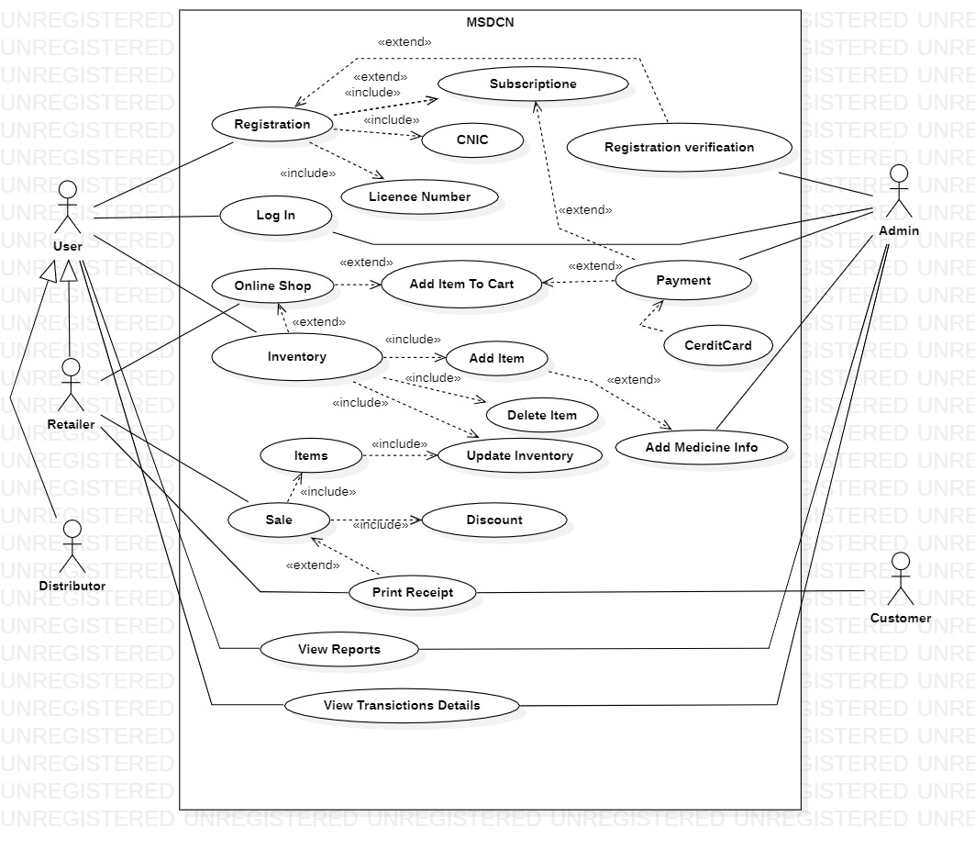
Use Case Diagram

Slide 11
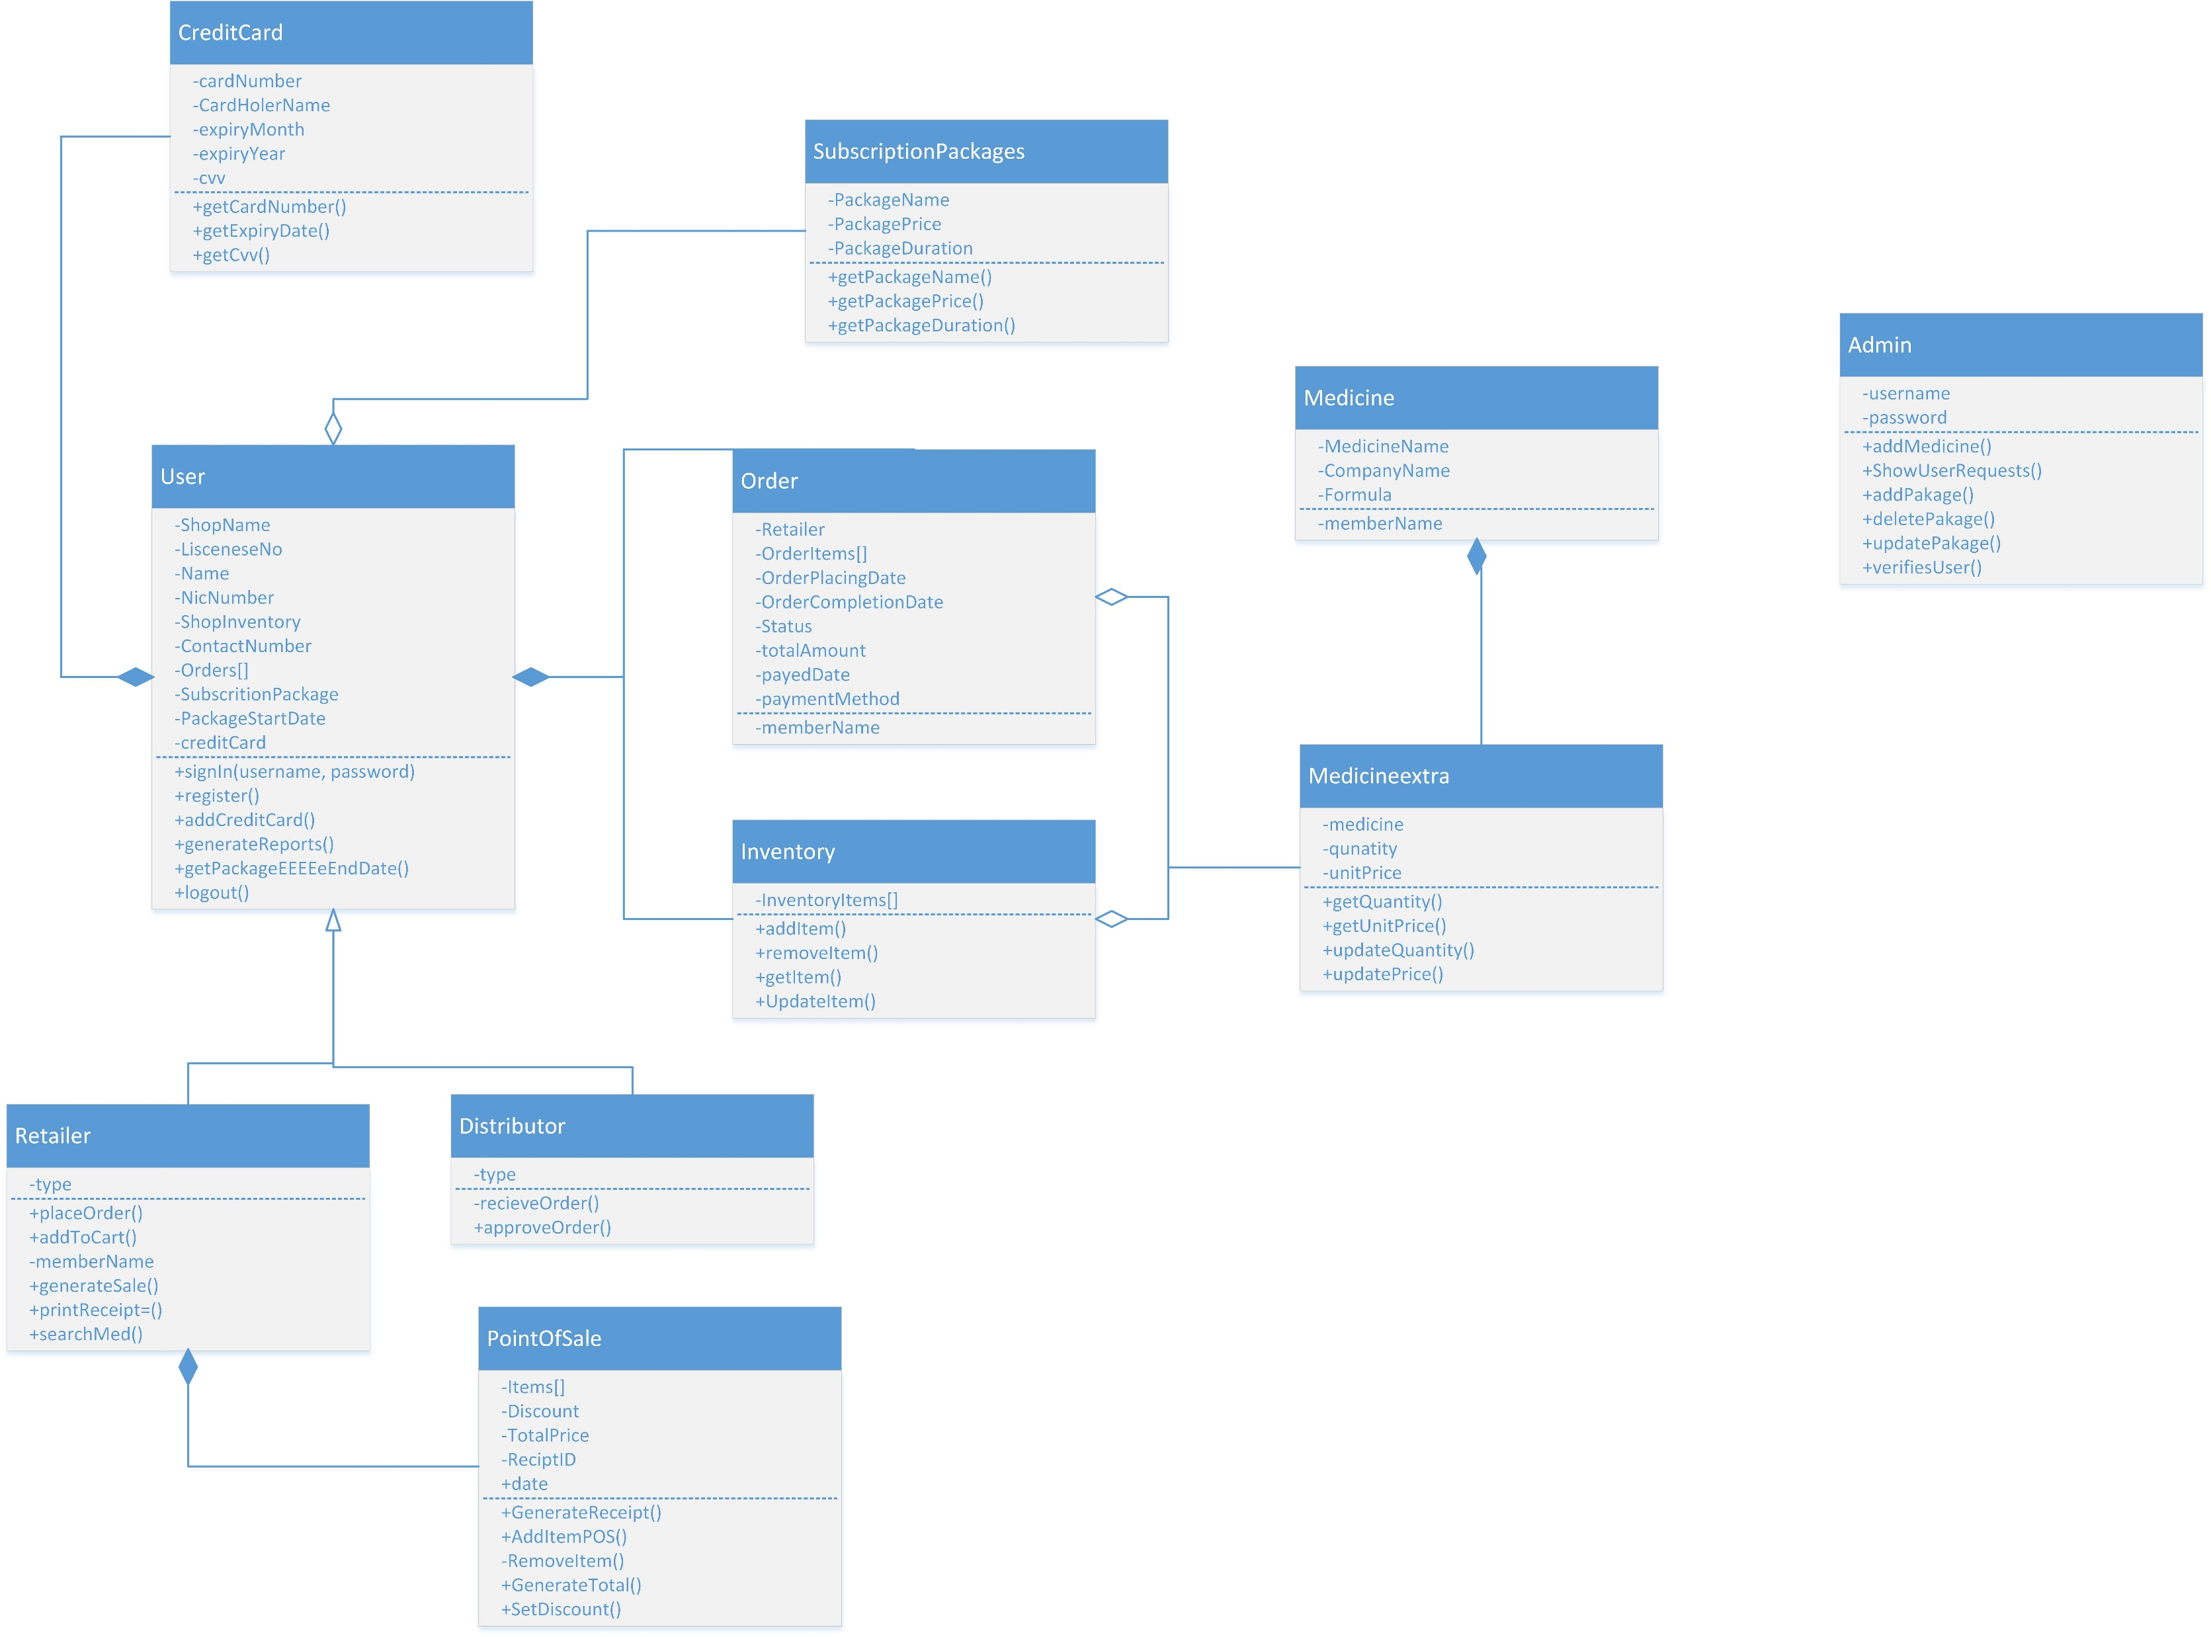
Class Diagram

Slide 12
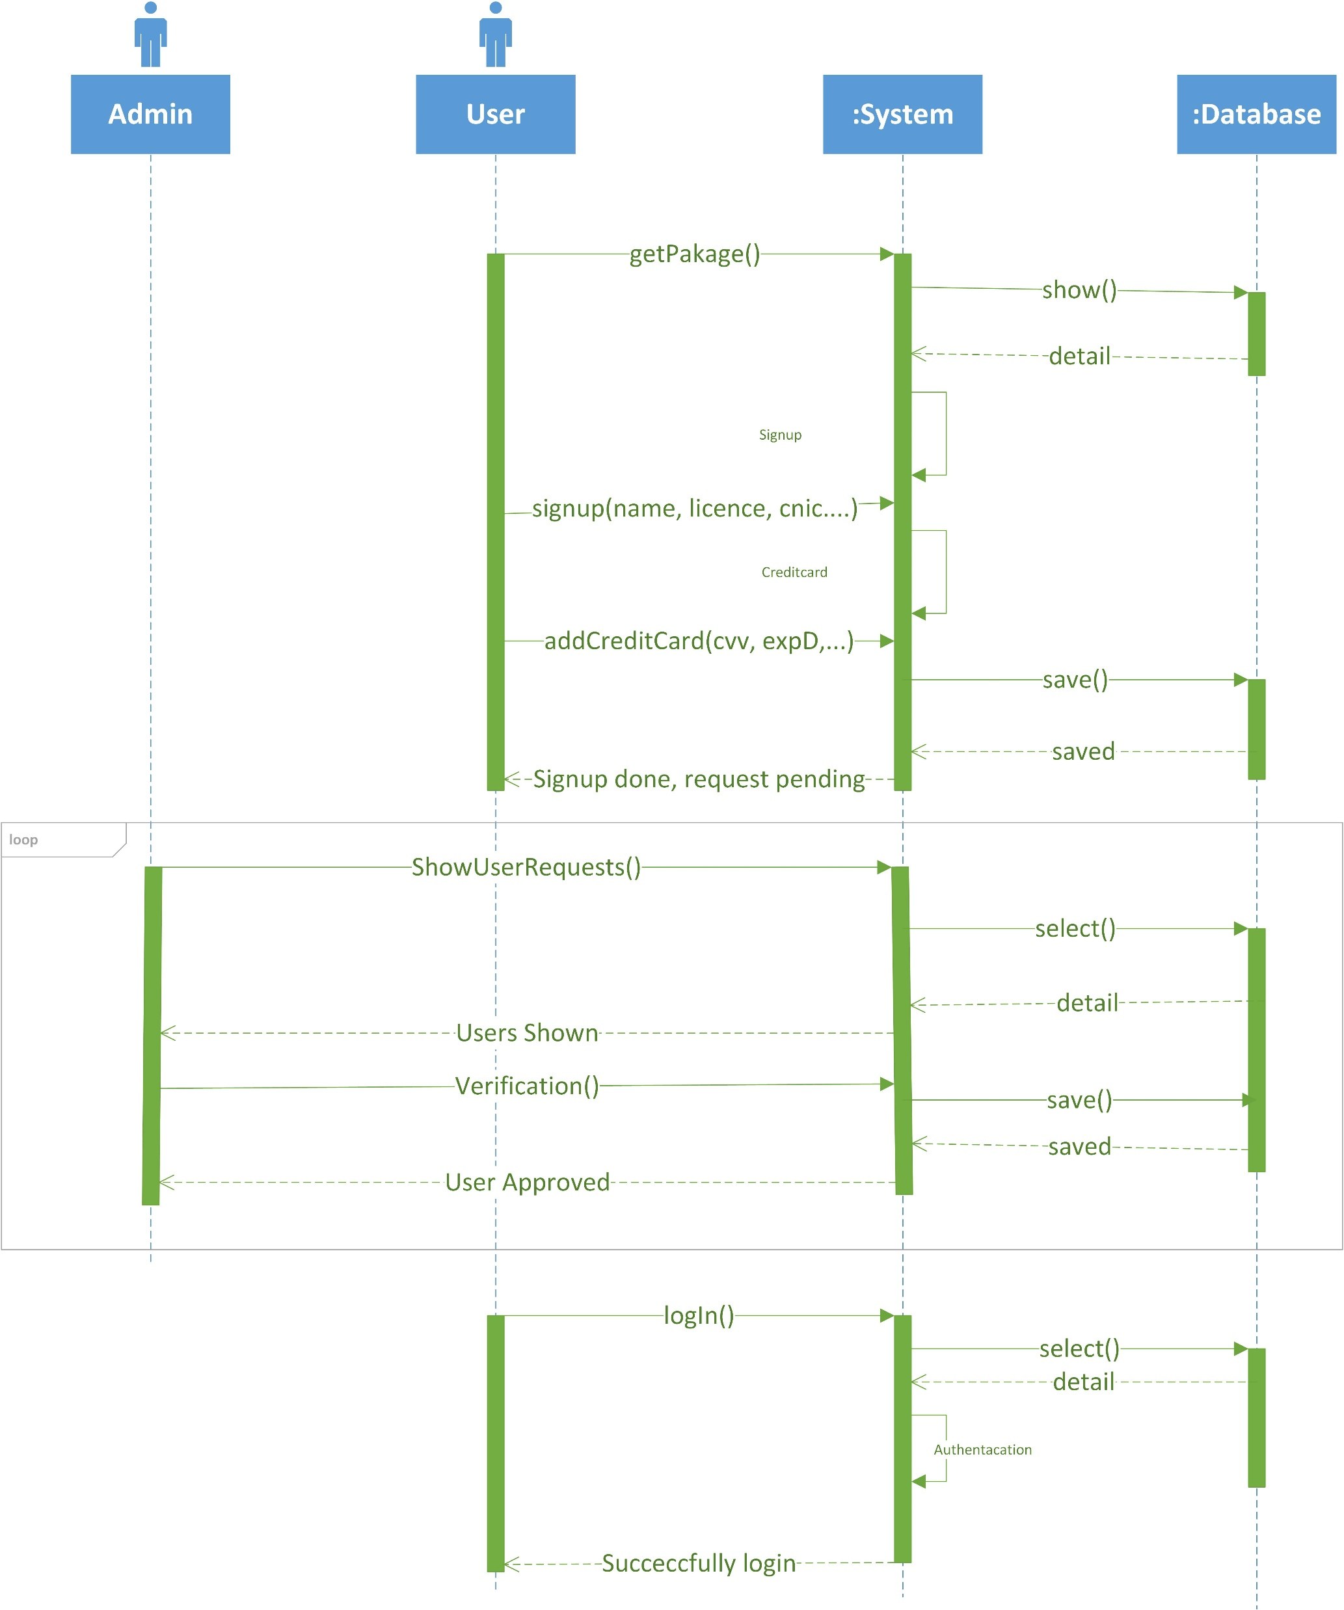
Sequence Diagram

Slide 13
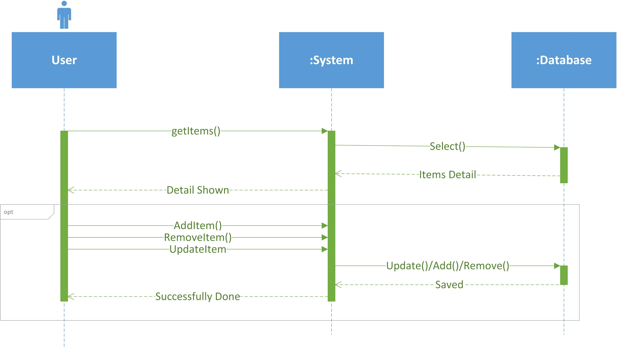
Sequence Diagram

Slide 14
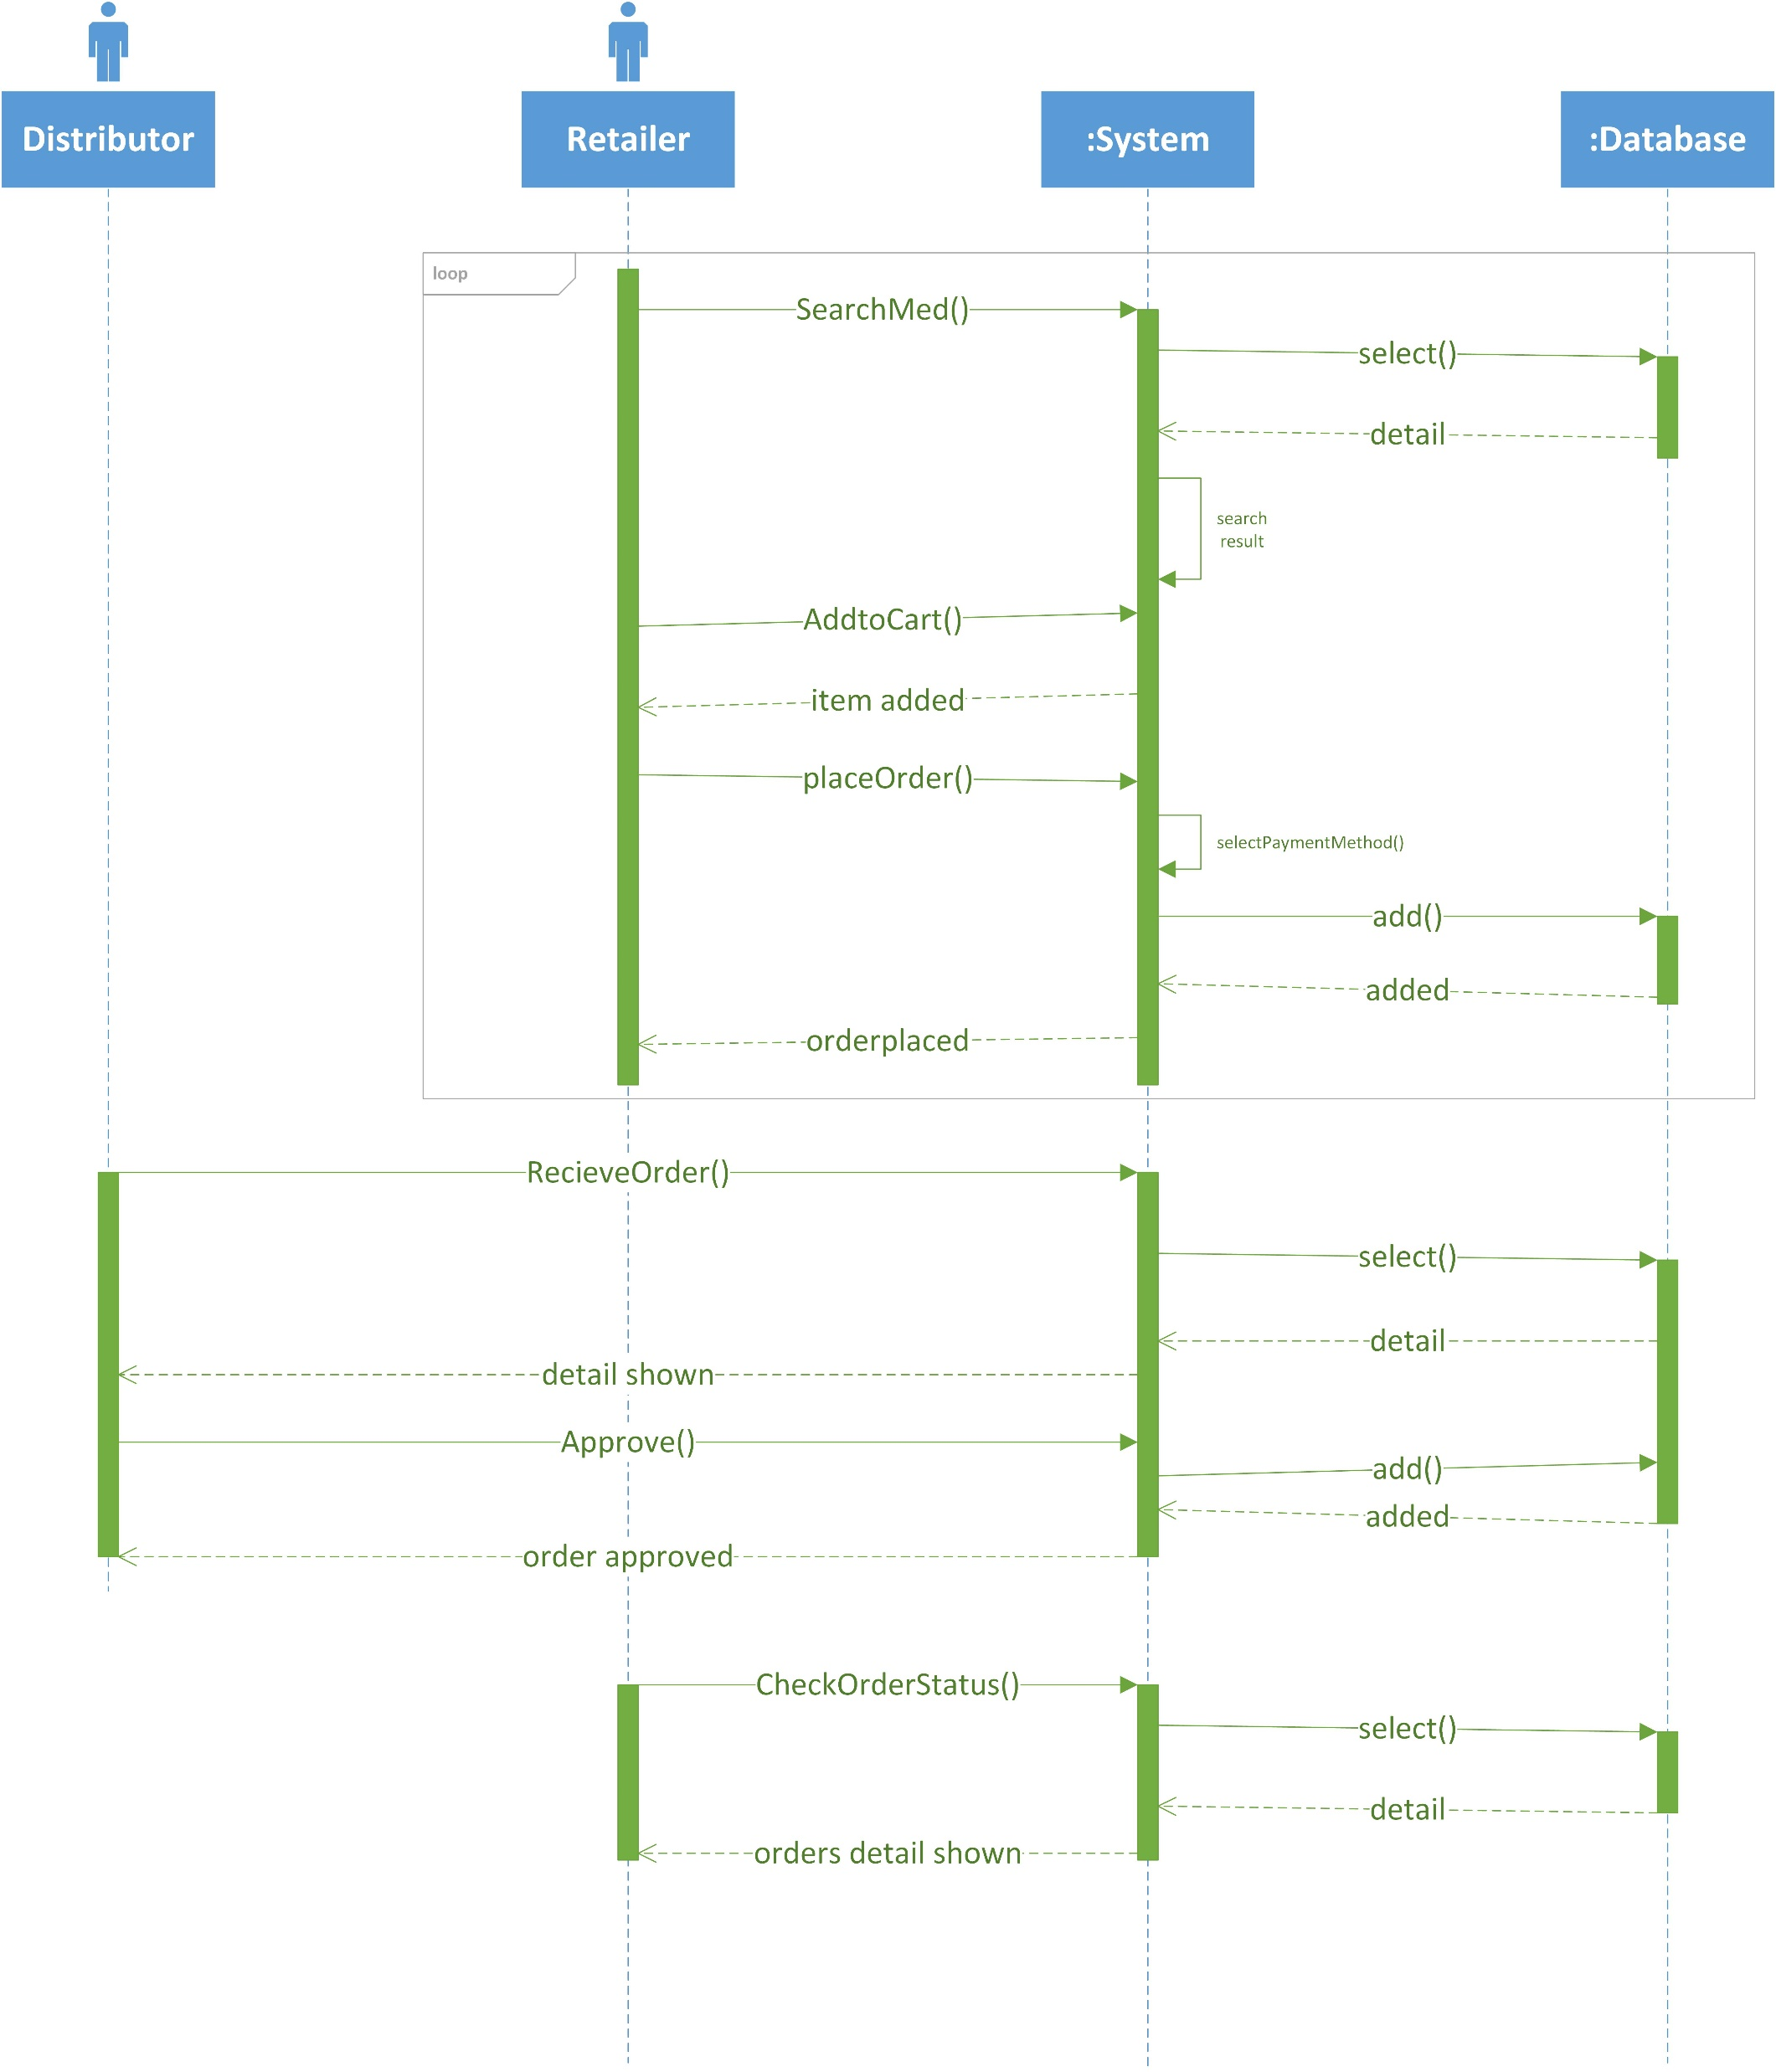
Sequence Diagram

Slide 15
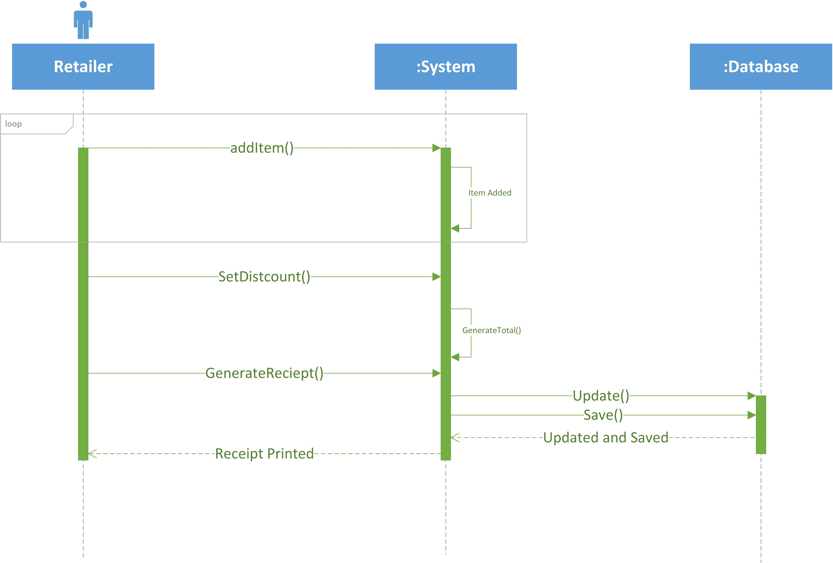
Sequence Diagram

Slide 16
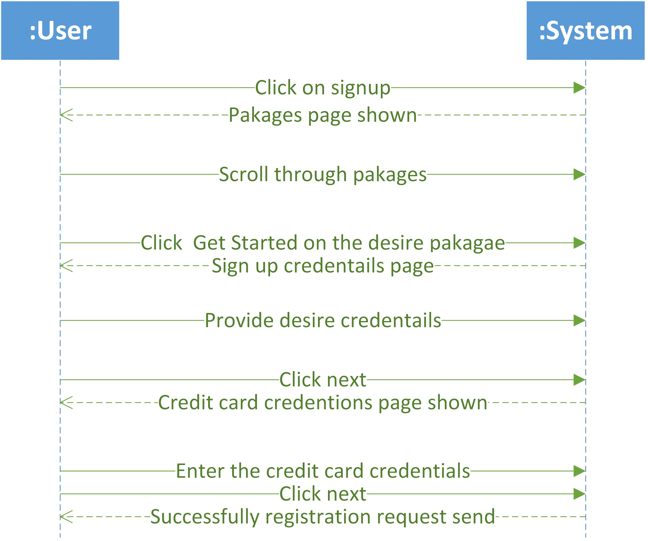
System Sequence Diagram

Slide 17
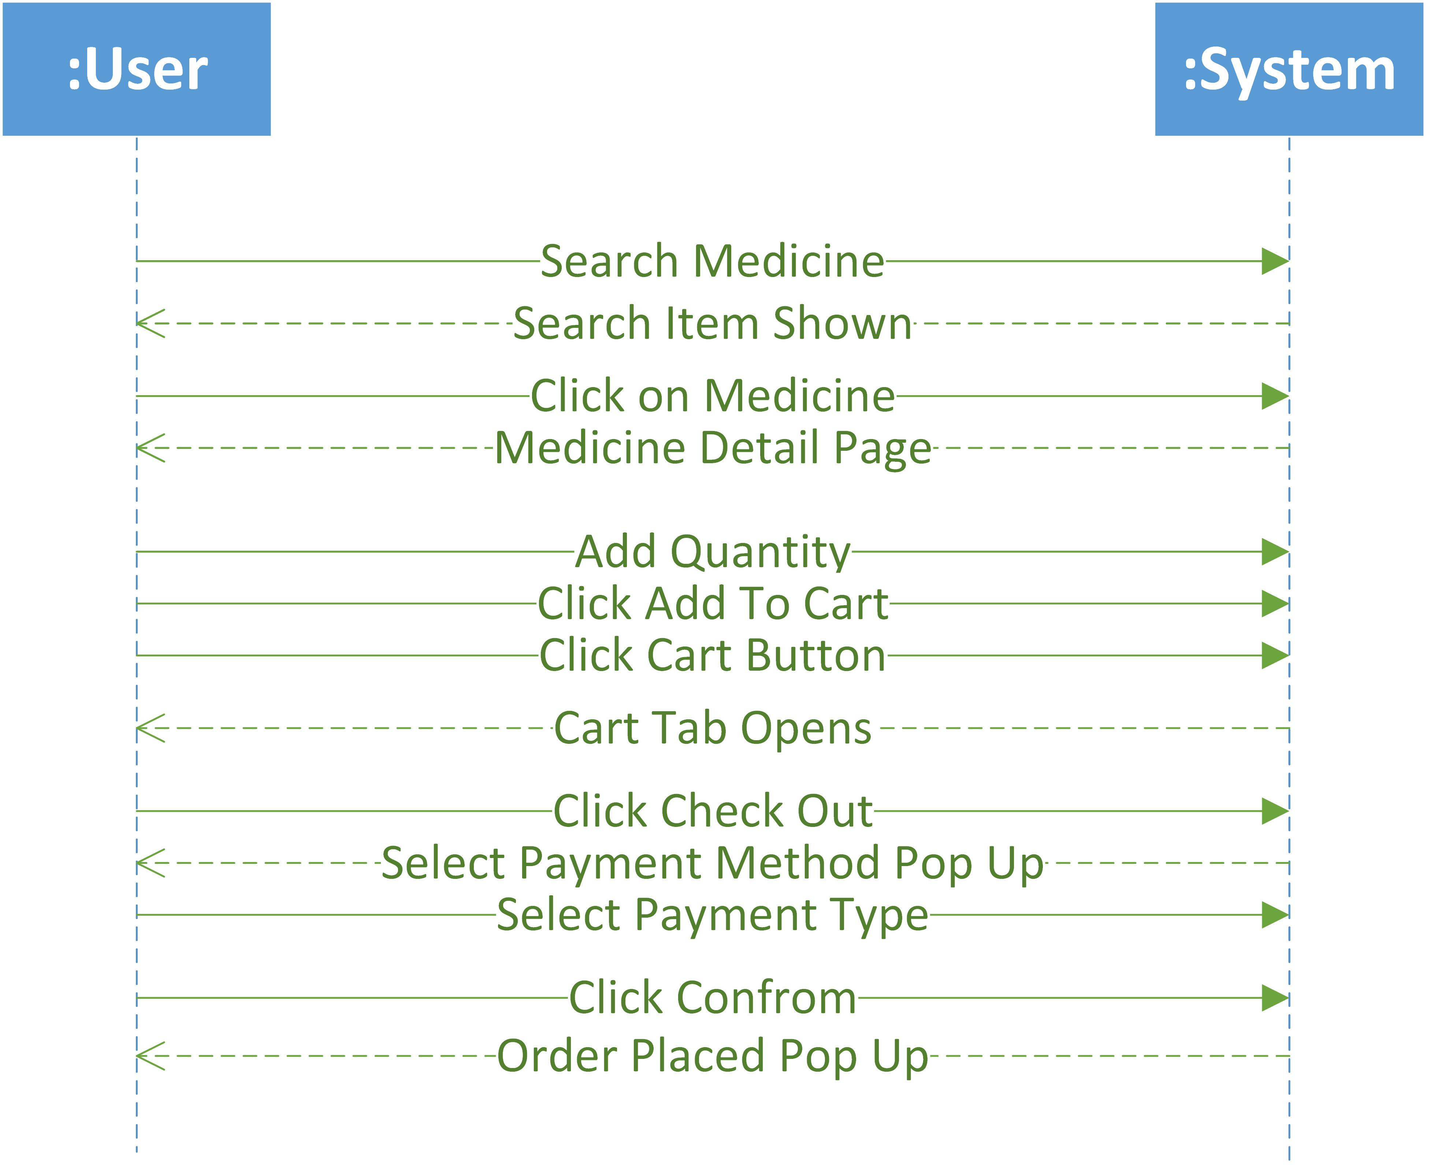
System Sequence Diagram

Slide 18
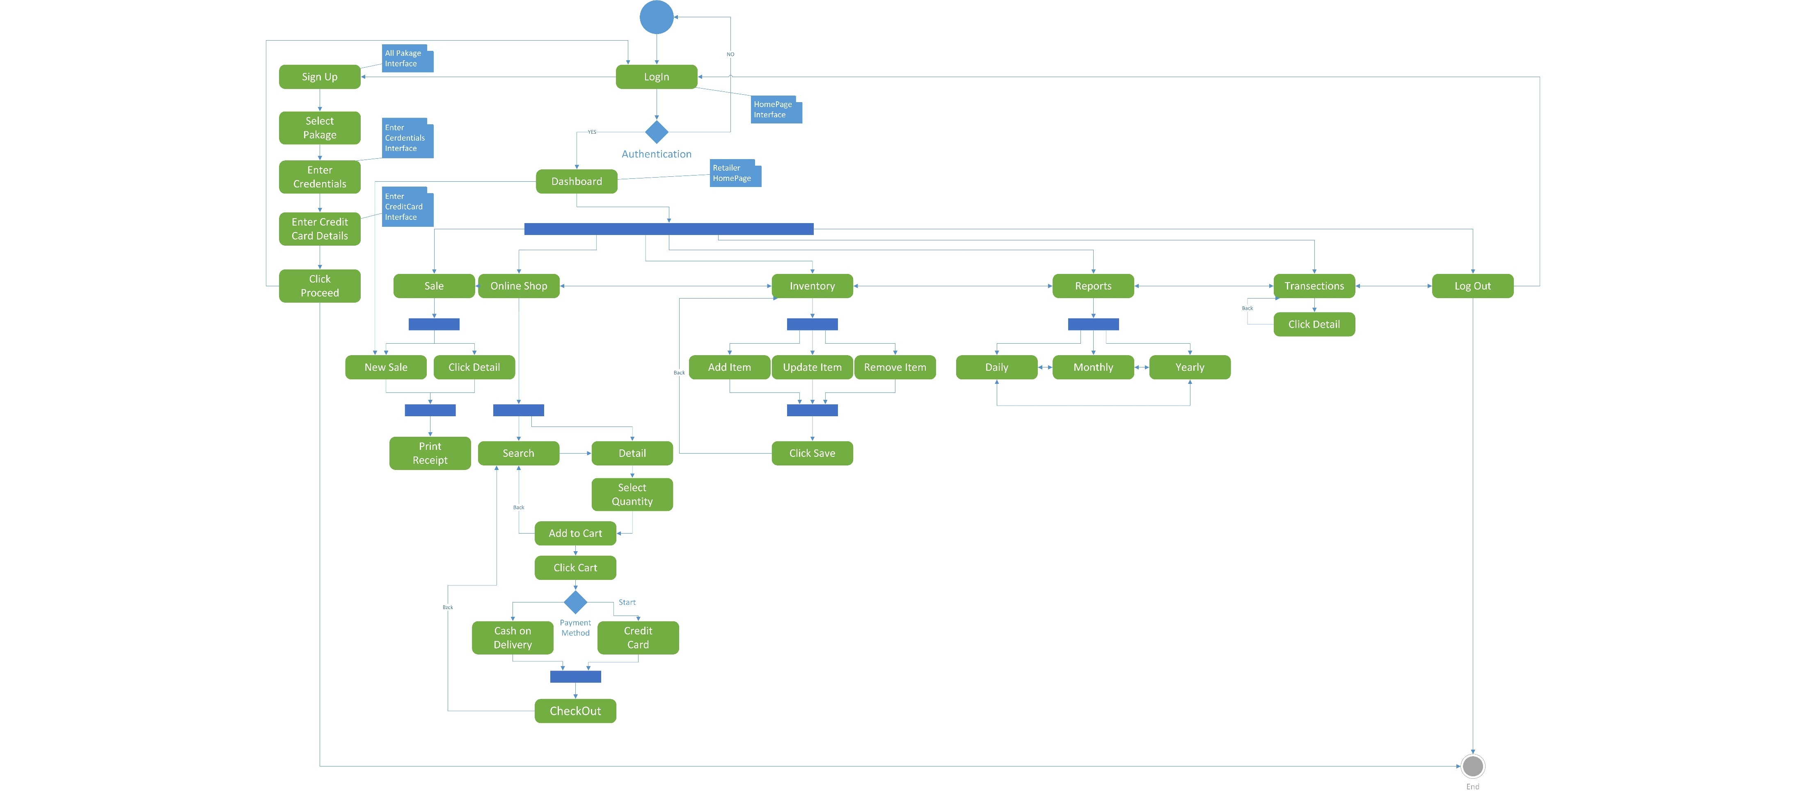
Activity/State Machine Diagram

Slide 19
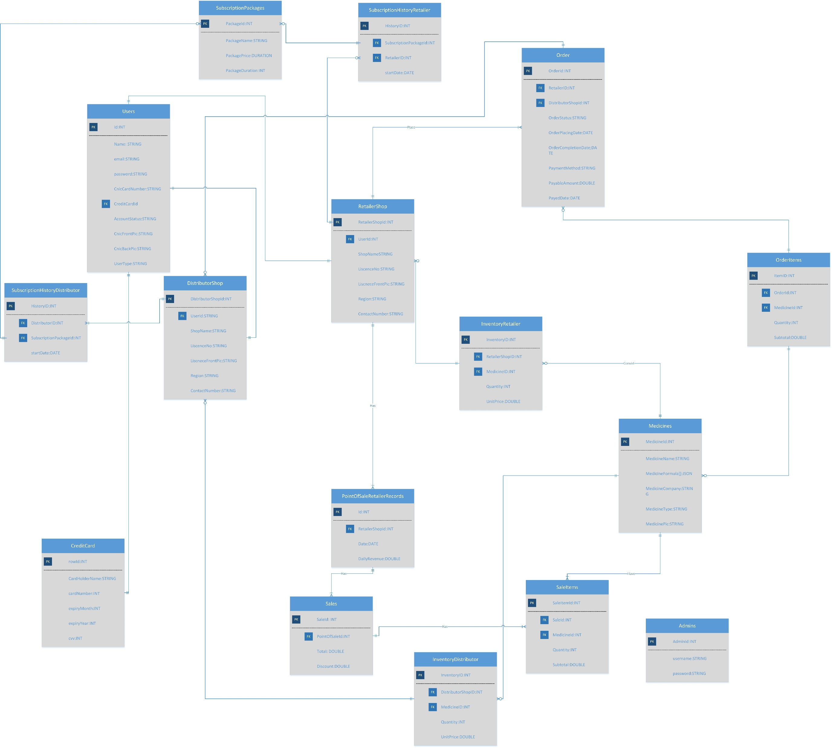
ER Diagram

Slide 20
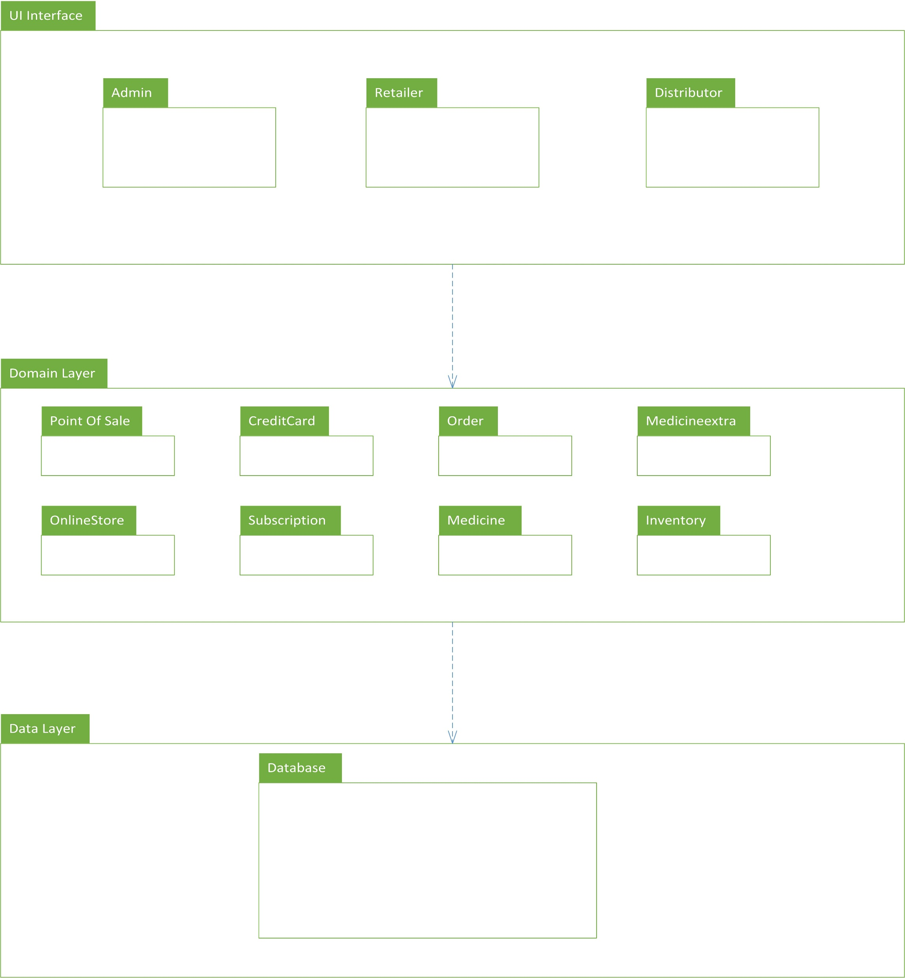
Package Diagram

Slide 21
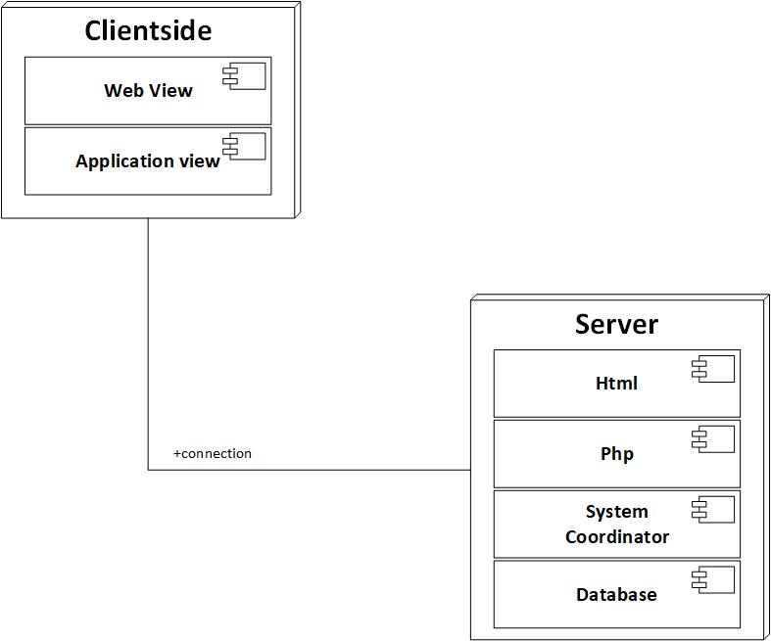
Deployment Diagram

Slide 22
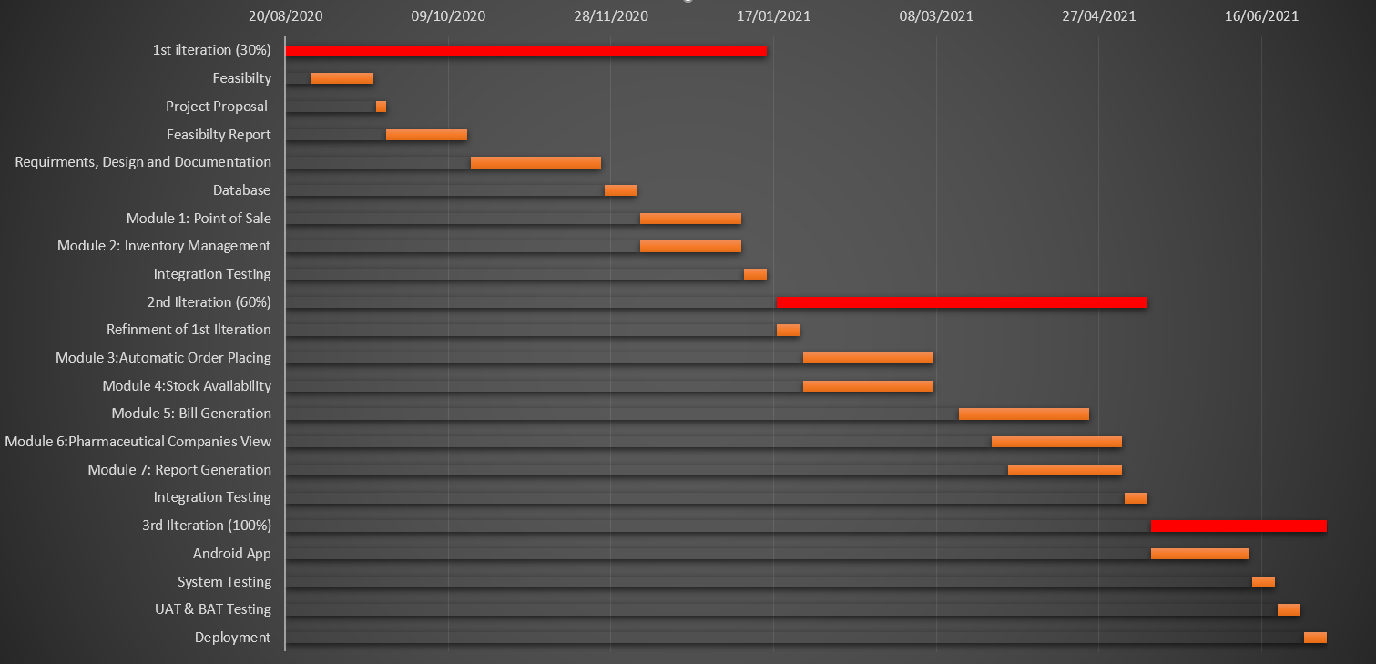
Schedule

Slide 23
Details of 1st Iteration (30%)
SRS
SDD
Database
Online Store

Slide 24
Details of 2nd Iteration (50%)
Point of sale
Inventory Management
Reports Generation

Slide 25
The End

